Slide 1
Check for Understanding
Complex and Compound Sentences
with BRIEF Review of Run Ons and Fragments
Focusing primarily on COMPLEX sentences

Slide 2
FIRST WHY IS IT important to be able to write compound and complex sentences?

Slide 3
Creates more sentence fluency and variety
LESS likely to write fragments or run-ons because you understand dependent and independent clauses better
A big part of the ACT
Required on ALL papers in this class
Demonstrates connections between ideas ( since they use words like because, since, although, even though)
Makes you a better writer

Slide 4
FIRST you need to understand dependent and independent clauses
Dependent Clauses (otherwise known as subordinate clauses) can NOT stand by themselves
Think a baby is DEPENDENT and can NOT stand on its own.
Independent Clauses can stand by themselves
Think when you are INDEPENDENT, you CAN stand on your own.

Slide 5
CHECK FOR UNDERSTANDING: Another name for a dependent clause would be
1) Fragment
2) Sentence
Notes:
🍐 This is a Pear Deck Multiple Choice Slide. Your current options are: A: 1, B: 2,
🍐 To edit the type of question or choices, go back to the "Ask Students a Question" in the Pear Deck sidebar.

Slide 6
ANSWER: Dependent Clauses are
#1 FRAGMENTS
Example:
since I am getting my license soon

Slide 7
CHECK FOR UNDERSTANDING: Another name for an independent clause would be:
1) Fragment
2) Sentence
Notes:
🍐 This is a Pear Deck Multiple Choice Slide. Your current options are: A: 1, B: 2,
🍐 To edit the type of question or choices, go back to the "Ask Students a Question" in the Pear Deck sidebar.

Slide 8
ANSWER Independent Clauses are:
#2 SENTENCES
Example:
I am getting a job.

Slide 9
CHECK FOR UNDERSTANDING: Because I love sports is a:
1) Dependent clause
2) Independent clause
Notes:
🍐 This is a Pear Deck Multiple Choice Slide. Your current options are: A: 1, B: 2,
🍐 To edit the type of question or choices, go back to the "Ask Students a Question" in the Pear Deck sidebar.

Slide 10
ANSWER: Because I love sports is a
#1 Dependent Clause (fragment)
It can NOT stand on its own

Slide 11
Compound Sentences
Join TWO independent Clauses w/ a COORDINATING CONJUNCTION – comma is always needed for compound sentences
FANBOYS (for, and, nor, but, or, yet, so)
I love to play sports, but I did not go out for basketball this year.

Slide 12
Run Ons are a NO NO
On quizzes you will need to identify fragments and run ons as well as to determine how to punctuate compound and complex sentences.
Quiz Questions re: run ons tend to be problematic for many students.
Run On: Two complete sentences WITHOUT punctuation or just a comma. A comma is NOT strong enough to join two complete sentences. You need to:
Use a period
Use a semicolon
Use a comma WITH a FANBOYS conjunction like for, and, nor, but, or, yet, so

Slide 13
Check for Understanding
I love fishing, I am going up to the cottage to catch perch.
Correct
Run On / Comma Splice
Notes:
🍐 This is a Pear Deck Multiple Choice Slide. Your current options are: A: correct, B: run on / comma splice,
🍐 To edit the type of question or choices, go back to the "Ask Students a Question" in the Pear Deck sidebar.

Slide 14
Answer:
I love fishing, I am going up to the cottage to catch perch.
This is INCORRECT AS IS.
This is a RUN ON because a comma is NOT strong enough to join two sentences.
Run ons can be short.

Slide 15
SELECT the correct answer:
a) I am hungry, so we are going out for pizza tonight after school.
b) I am hungry. We are going out for pizza after school.
c) I am hungry; we are going out for pizza.
d) I am hungry; therefore, we are going out for pizza
e) ALL of the above
Notes:
🍐 This is a Pear Deck Multiple Choice Slide. Your current options are: A: a, B: b, C: c, D: d, E: e,
🍐 To edit the type of question or choices, go back to the "Ask Students a Question" in the Pear Deck sidebar.

Slide 16
ALL ARE CORRECT
a) I am hungry, so we are going out for pizza tonight after school. comma / conjunction 😊
b) I am hungry. We are going out for pizza after school.😊 two separate sentences
c) I am hungry; we are going out for pizza.😊 semicolon can be used anywhere a period can be
d) I am hungry; therefore, we are going out for pizza😊 TRANSITION words (NOT conjunctions) often used with semicolons. SEE note above

Slide 17
Complex Sentence are a bit more tricky
Joins an INDEPENDENT clause and a DEPENDENT CLAUSE
If the dependent clause comes first, you need a comma.
If the dependent clause comes second, you do NOT need a comma.

Slide 18
REVIEW:
Because I am getting my license, I am getting a job soon. (complex)
I am getting a job soon because I am getting my license. (complex)
I am getting my license, and I am getting a job soon. (compound sentence)

Slide 19
CHECK FOR UNDERSTANDING:
Since I am graduating next year, I need to visit college campuses.
I need to visit college campuses since I am graduating next year.
Are they both correct?
YES OR NO?
Notes:
🍐 This is a Pear Deck Multiple Choice Slide. Your current options are: A: YES they are both CORRECT, B: NO they are NOT both Correct,
🍐 To edit the type of question or choices, go back to the "Ask Students a Question" in the Pear Deck sidebar.

Slide 20
CHECK FOR UNDERSTANDING:
YES
They are BOTH correct!

Slide 21
CHECK for UNDERSTANDING
Even though my brother and I fought, he taught me a lot.
1) Correct As Is
2) Run on
3) Delete the Comma
Notes:
🍐 This is a Pear Deck Multiple Choice Slide. Your current options are: A: 1, B: 2, C: 3,
🍐 To edit the type of question or choices, go back to the "Ask Students a Question" in the Pear Deck sidebar.

Slide 22
ANSWER:
1) CORRECT AS IS
Even though my brother and I fought, he taught me a lot.
Dependent clause followed by an independent clause
When the dependent clause comes first, you need the comma

Slide 23
CHECK FOR UNDERSTANDING:
Even though I have several pets I still want another cat.
1) Correct As Is
2) Add a Comma
3) Run on
Notes:
🍐 This is a Pear Deck Multiple Choice Slide. Your current options are: A: 1, B: 2, C: 3,
🍐 To edit the type of question or choices, go back to the "Ask Students a Question" in the Pear Deck sidebar.

Slide 24
ANSWER:
#2) ADD A COMMA
Even though I have several pets, I still want another cat.
Comma needed after the dependent clause

Slide 25
Drag your dot to how you are feeling:
Keep going, I understand
I’m a little confused
Stop, I need help!
Notes:
Temperature Check
WIth this slide, you can get a quick idea of how your students are feeling about the pace of the lesson. Getting consensus before moving on helps ensure everyone is still with you, and identify the students who might need extra attention.
🍐 This is a Pear Deck Draggable™ Slide.
🍐 To edit the type of question, go back to the "Ask Students a Question" in the Pear Deck sidebar.

Slide 26
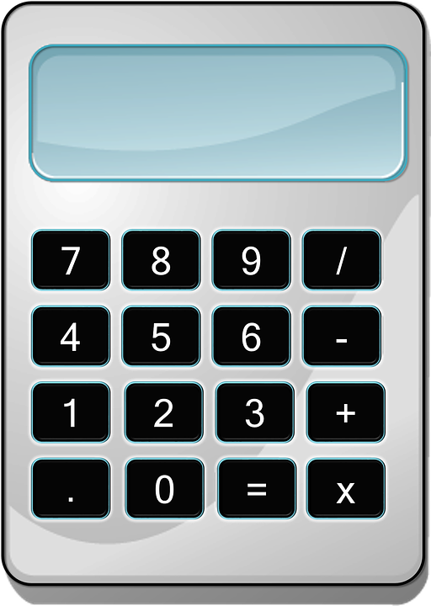
CHECK FOR UNDERSTANDING:
I am going to become an engineer because I am a strong math student.
1) Correct as is
2) Add a Comma
3) Run On
Notes:
🍐 This is a Pear Deck Multiple Choice Slide. Your current options are: A: 1, B: 2, C: 3,
🍐 To edit the type of question or choices, go back to the "Ask Students a Question" in the Pear Deck sidebar.

Slide 27
ANSWER:
#1) CORRECT AS IS 😋😋
I am going to become engineer because I am a strong math student.
NO comma needed when the dependent clause comes second

Slide 28
Check for Understanding
A blizzard is expected, school is being cancelled.
Correct As Is
Run On / Comma Splice
Notes:
🍐 This is a Pear Deck Multiple Choice Slide. Your current options are: A: Correct as is, B: Run On /Comma Splice,
🍐 To edit the type of question or choices, go back to the "Ask Students a Question" in the Pear Deck sidebar.

Slide 29
RUN ON / FRAGMENT
A blizzard is expected, school is being cancelled.
A comma is NOT strong enough to join two sentences. You need:
period
comma and FANBOYS (for, and, nor, but, or, yet, so)
semicolon

Slide 30
You CAN start a sentence with Because
TRUE
FALSE
Notes:
🍐 This is a Pear Deck Multiple Choice Slide. Your current options are: A: true, B: false,
🍐 To edit the type of question or choices, go back to the "Ask Students a Question" in the Pear Deck sidebar.

Slide 31
TRUE
😉 Yes, you CAN start a sent. w because
Starting a sentence DOES create a dependent clause (otherwise known as a fragment). HOWEVER, IF (and only IF) you join it with a complete sentence, it is ok.
In fact, it creates a complex sentence. Example:
Because I love cats, I have two of them.

Slide 32
Circle how you are feeling:
Notes:
🍐 This is a Pear Deck Draggable™ Slide.
🍐 To edit the type of question, go back to the "Ask Students a Question" in the Pear Deck sidebar.
Emotion Check
Use this template to prompt students to check in with themselves. This will also help you gauge the mood in your classroom and notice any students who might attention.

Slide 33
NEED more PRACTICE?
ONLINE games and interactive review on my web page CLICK HERE
Click on Grammar and Complex Sentences
EVERY paper requires an underlined complex sentence!
This is concept is tested throughout the year as well.

Slide 34
EXIT TICKET:
WRITE a complex sentence that STARTS w/ a dependent clause.
HINT you will want to START w/ a SUBORDINATING CONJUNCTION (i.e. because, since, even though, although)
Be sure to use a subordinating conjunction and NOT a transition word
Notes:
🍐 This is a Pear Deck Text Slide
🍐 To edit the type of question, go back to the "Ask Students a Question" in the Pear Deck sidebar.

